Slide 1
Data Types
Variable:
A Variable is a Named Memory block where we can store the value.
Data types:
specifies what type of data we store in the variable or memory location.
Data types are two types
Value types
Reference types
Value types:
In Value types the memory size of the data type will be fixed
Value types are stored on the stack Memory
Value types are accessed directly.
Value types are initialized to 0(Zero) when they are created. [default value of the value type data type is zero]

Slide 2
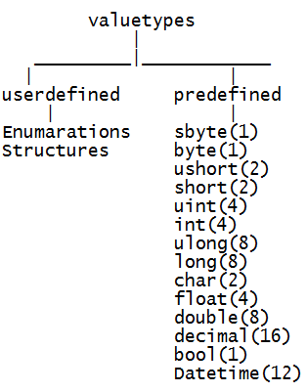
Value type Data types

Slide 3
Reference Types
Reference types:
In reference types the memory size will not be fixed
reference types are stored in heap memory.
The default value of reference type is null.

Slide 4
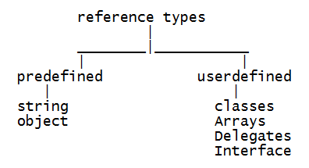
Reference Types

Slide 5
Reference Types
F,f--float
float f=12.23F
D,d--Double
double d=23.34D
M,m--Decimal
decimal dc=0.987M
L--Long
long l=234L
Ul--Unsigned Long

Slide 6
Stack and Heap
STACK
The stack is a place in the computer memory where all the variables that are declared and initialized before runtime are stored.
Stack is used for temporary storage of information.Once we close the program the memory of the variable will not no more there. HEAP
The heap is the section of computer memory where all the variables created or initialized at runtime are stored.
it is a permanent memory. it is used for dynamic memory allocation. when we come out from the program still the memory will be allocated to the variable or objects.

